Slide 1
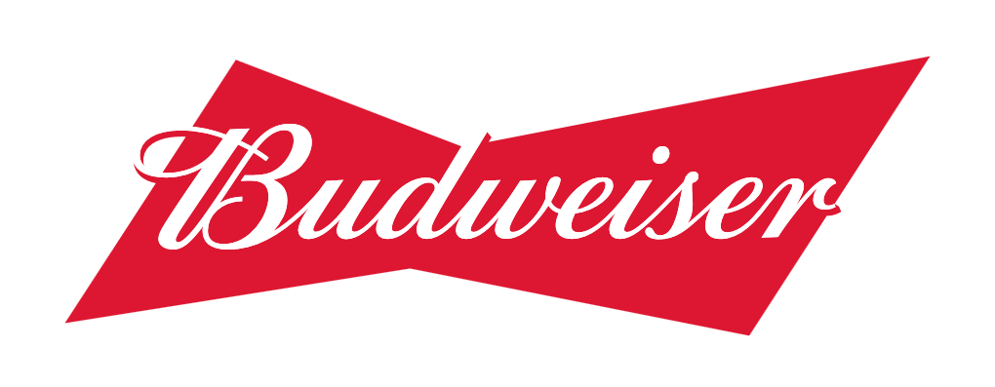
Craft Breweries in the US
A review of Alcohol by Volume and Bitterness across Breweries in the United States
https://www.youtube.com/watch?v=TtA6nAEoXpk
Analysis by Josh Eysenbach and Julia Layne
Notes:
So today we are continuing Budweiser’s exploration into the craft beer market, and we’ve been asked to answer some questions for the management team regarding craft beers across the country – specifically today related to their alcohol by volume and bitterness, and then we’re going to spend a little time discussing how our brewers can use some of this information as they develop a new beer label that will get the company’s foot in the door of the craft market.

Slide 2
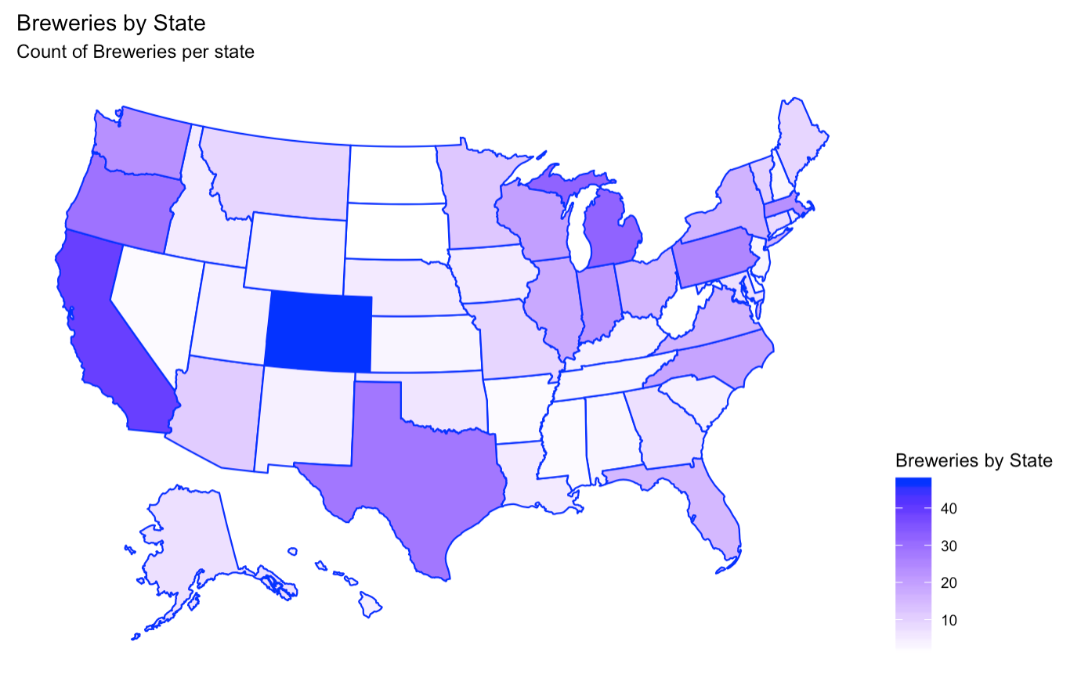
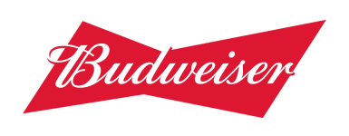
Number of Breweries per State
State | Breweries |  | State | Breweries
CO | 47 |  | MD | 7
CA | 39 |  | OK | 6
MI | 32 |  | IA | 5
OR | 29 |  | ID | 5
TX | 28 |  | LA | 5
PA | 25 |  | NE | 5
MA | 23 |  | RI | 5
WA | 23 |  | HI | 4
IN | 22 |  | KY | 4
WI | 20 |  | NM | 4
NC | 19 |  | SC | 4
IL | 18 |  | UT | 4
NY | 16 |  | WY | 4
VA | 16 |  | AL | 3
FL | 15 |  | KS | 3
OH | 15 |  | NH | 3
MN | 12 |  | NJ | 3
AZ | 11 |  | TN | 3
VT | 10 |  | AR | 2
ME | 9 |  | DE | 2
MO | 9 |  | MS | 2
MT | 9 |  | NV | 2
CT | 8 |  | DC | 1
AK | 7 |  | ND | 1
GA | 7 |  | SD | 1
 |  |  | WV | 1
Top 5: Colorado, California, Michigan, Oregon, and Texas
Notes:
Our first task was to look at the total numner of craft breweries in each state and we can see that CO looks like the mecca of craft brewing with the most by far, and Cal Mich, Oregon, and TX rounding out the top 5.

Slide 3
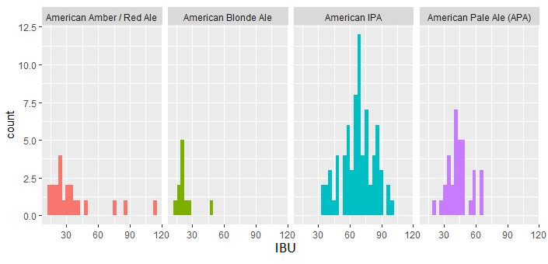
Missing Data
We found values vary greatly by beer type and within types
There are 1005 beers with missing values for IBU
We’ve decided to remove the missing values to avoid distorting results replacing over 40% of the data
Missing Values
ABV: 62
IBU: 1005
Style: 5
Notes:
One of big issues with this dataset is that it is missing quite a bit of data. Notably bitterness as it usually isn’t a required measurement so no surprise there, but we have to deal with this missing data somehow. I wouldn’t be prudent to impute these values because of how much they vary, which we can see when we plot few styles and look at their ranges. We would basically just be making up data and It would likely lead us to incorrect conclusions in any analysis using these values. We decided it would be best to remove the beers with missing data from this analysis, despite the fact that it unfortunately removes about 40% of the beers on the list. There were also a few missing ABV and style – those were removed as well.

Slide 4
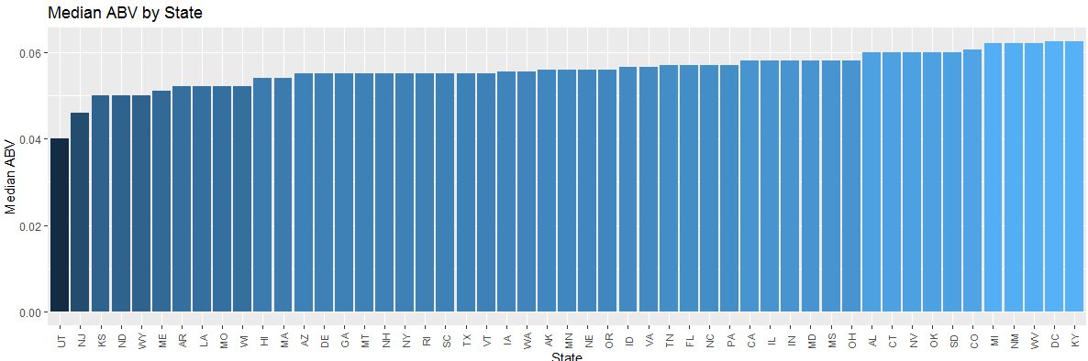
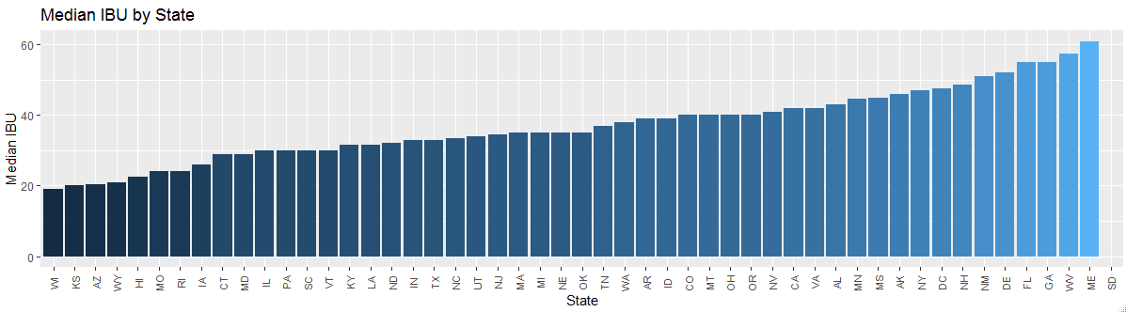
Median ABV and IBU by State
Notes:
Next we were asked to look at the median ABV and IBU for all 50 states. For ABV theres not much variation as far as the median goes - Utah actually has some laws limiting abv, most states stick pretty close to that 5-6 range%
The median IBU looks to be much more varied across the country, but really the bookends of this plot are the states with few breweries in the dataset so their medians are going to be determined by very few samples, where as the states with many breweries fall in the middle with around 30-50 units as there is just a broader range of beers in those states that averages out the values.

Slide 5
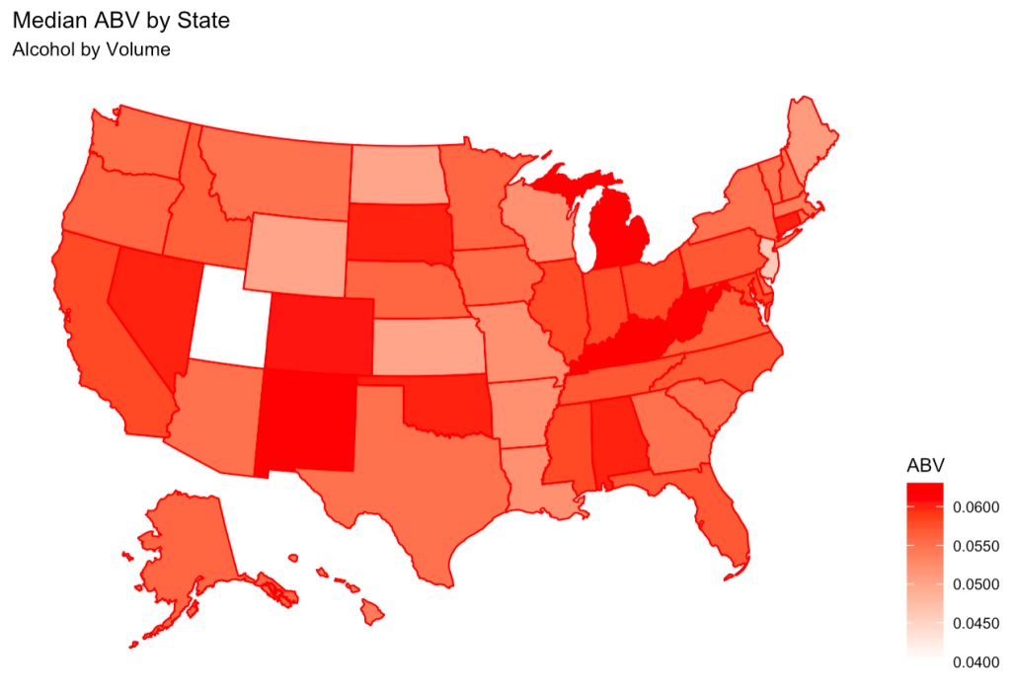
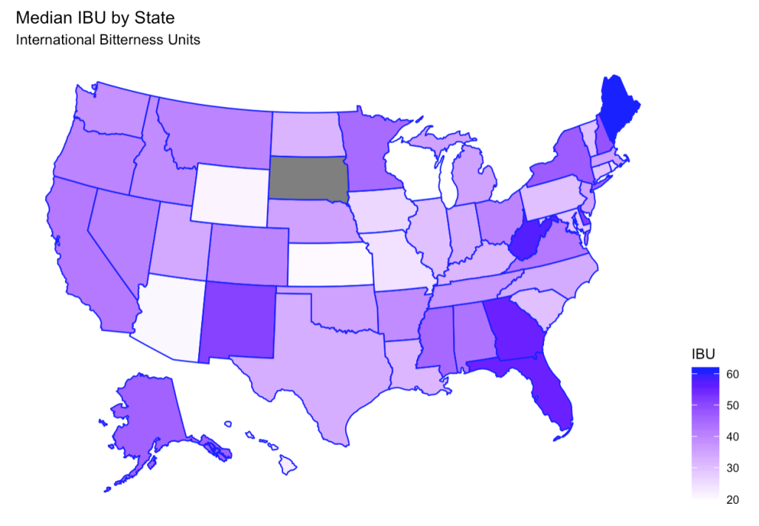
Median ABV and IBU by State
State | Median ABV | Median IBU |  | State | Median ABV | Median IBU |  | State | Median ABV | Median IBU |  | State | Median ABV | Median IBU
AK | 0.056 | 46.0 |  | IL | 0.058 | 30.0 |  | MS | 0.058 | 45.0 |  | PA | 0.057 | 30.0
AL | 0.060 | 43.0 |  | IN | 0.058 | 33.0 |  | MT | 0.055 | 40.0 |  | RI | 0.055 | 24.0
AR | 0.052 | 39.0 |  | KS | 0.050 | 20.0 |  | NC | 0.057 | 33.5 |  | SC | 0.055 | 30.0
AZ | 0.055 | 20.5 |  | KY | 0.063 | 31.5 |  | ND | 0.050 | 32.0 |  | SD | 0.060 | NA
CA | 0.058 | 42.0 |  | LA | 0.052 | 31.5 |  | NE | 0.056 | 35.0 |  | TN | 0.057 | 37.0
CO | 0.061 | 40.0 |  | MA | 0.054 | 35.0 |  | NH | 0.055 | 48.5 |  | TX | 0.055 | 33.0
CT | 0.060 | 29.0 |  | MD | 0.058 | 29.0 |  | NJ | 0.046 | 34.5 |  | UT | 0.040 | 34.0
DC | 0.063 | 47.5 |  | ME | 0.051 | 61.0 |  | NM | 0.062 | 51.0 |  | VA | 0.057 | 42.0
DE | 0.055 | 52.0 |  | MI | 0.062 | 35.0 |  | NV | 0.060 | 41.0 |  | VT | 0.055 | 30.0
FL | 0.057 | 55.0 |  | MN | 0.056 | 44.5 |  | NY | 0.055 | 47.0 |  | WA | 0.056 | 38.0
GA | 0.055 | 55.0 |  | MO | 0.052 | 24.0 |  | OH | 0.058 | 40.0 |  | WI | 0.052 | 19.0
HI | 0.054 | 22.5 |  | MS | 0.058 | 45.0 |  | OK | 0.060 | 35.0 |  | WV | 0.062 | 57.5
ID | 0.057 | 39.0 |  | MO | 0.052 | 24.0 |  | OR | 0.056 | 40.0 |  | WY | 0.050 | 21.0
Notes:
These maps show with darker colors which states have higher ABV on the left and IBU on the right. There really doesn’t appear to be much of a regional trend in regards to either IBU or ABV, and again some of the states that look particularly high or low are likely just because of small sample sizes for those states so we probably couldn’t glean much about brewer or consumer preferences from that anyway.

Slide 6
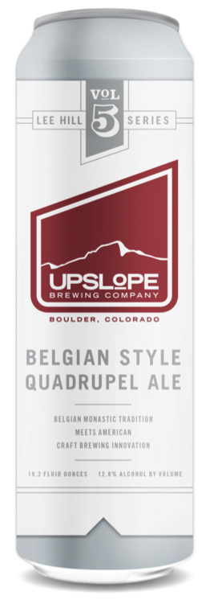
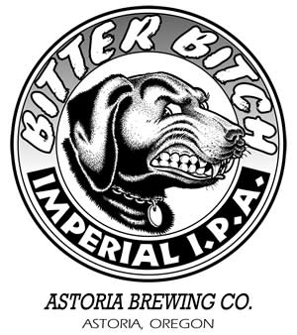
States with Highest ABV and IBU
States with Highest Median ABV:
Kentucky and Washington D.C (6.25%)
State with Highest Median IBU: Maine
(61)
The beer with the highest ABV is located in Colorado
(Lee Hill Series Vol. 5 Belgian Quadrupel Ale)
The beer with the highest IBU is located in Oregon
(Bitter Bitch Imperial IPA)
Notes:
So from that data we found that the states with the highest ABV were Kentucy and D.C. at 6.25% and the state with the highest IBU is Maine at 61 units. We also found out which specific beers had the highest values and where they located.
The most alcoholic beer is made by upslope brewery in Colorado and it has a 12.8% ABV
BB IPA – 138 IBU

Slide 7
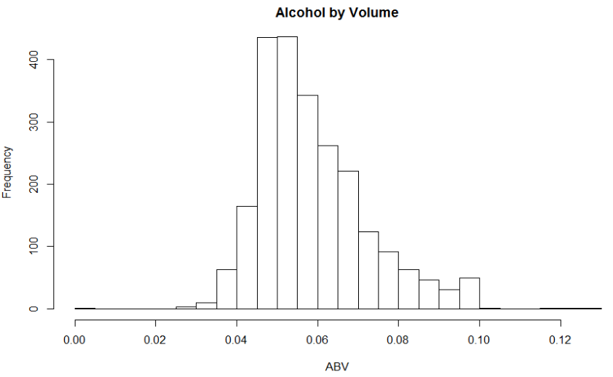
Stats and Distribution of ABV
Mean | Std. dev. | Min | 1st Q | Median | 3rd Q | Max
0.06 | 0.014 | 0.001 | 0.05 | 0.056 | 0.067 | 0.128
Notes:
Looking at the overall distribution of alchol content of all of the beers in the dataset, we found that The distribution of ABV appears fairly normal to maybe slightly right-skewed.
-median ABV is about 5.6% which is consistent with what we saw when looking at all of the state medians. 75% of the data is contained within the range of 5% to 6.7% ABV, this indicates that most beers tend to stick close to that median ABV.
-The max of 12.8% for the Uplslope beer we just looked at is a full five standard deviations from the mean so beers this high can definitely be considered rare outliers.

Slide 8
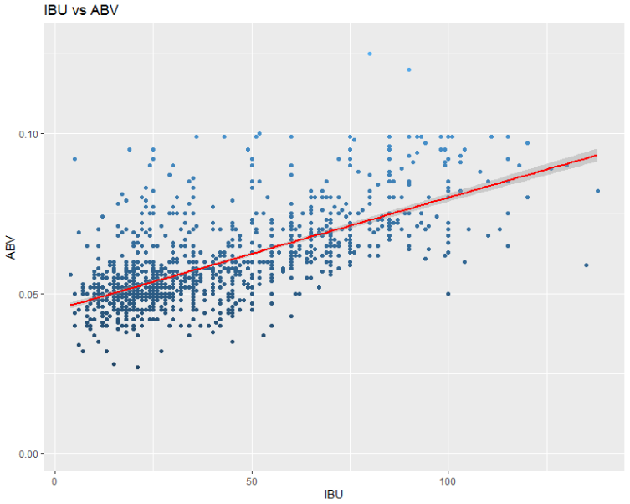
Relationship Between IBU and ABV
r = .67
ABV = .00035*IBU + .0449
Notes:
You also wanted to see if there was any relationship between IBU and ABV – and Based on a scatter plot, there does appear to be evidence of a moderate positive correlation. The ABV looks like it trends upward as bitterness increases…and a calculated correlation coefficient of .67 supports this. If we wanted to describe that relationship with a linear model, we could use the equation below.

Slide 9
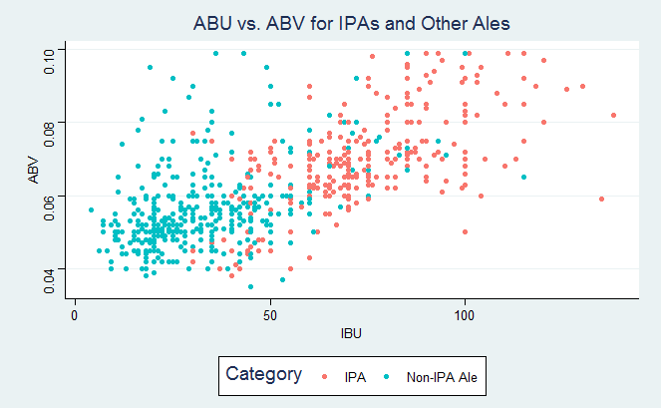
IPAs vs. Other Ales
Is there a difference between IPAs and other Ales with respect to IBU and ABV?
Using the K Nearest Neighbors method with tuned K value of 5, the model correctly classified approx 87% of beers in these categories as an IPA or a different Ale.
Notes:
So now as we get more into Budweiser’s prospects as far as developing something new, one of the questions posed to us was if we could recognize any differences between the alcohol content and bitterness of IPAs vs Ales of any other type. So if we separate the beers in our dataset that fall into one of these two categories and plot their ABV and IBU, we can see the groups emerge with some separation where the IPAs tend to appear higher in both bitterness and alcohol content than other style ales. We tested this using a KNN classification model with a tuned K of 5, where we let the model classify each beer based on its 5 closest neighboring points on this plot. The model accurately classified about 87% of the beers into these two categories, which indicates that there is some good evidence that these can be identified pretty well as an IPA or other ale based on these variables alone.

Slide 10
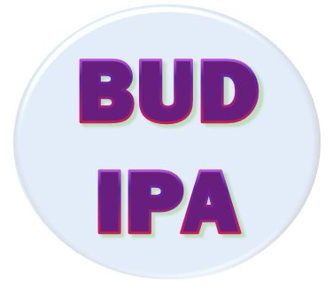
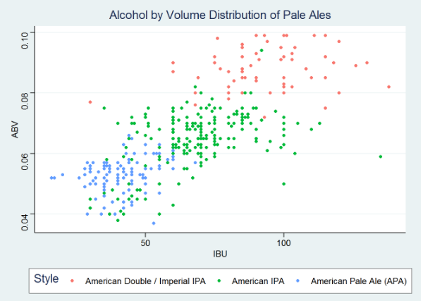
A New Beer Label
Marketing team has argued that the “IPA” name will target the largest group of craft beer drinkers
Can the brewers make a “lighter” IPA and still keep the name?
There appear to be fairly clear groups for different types of pale ales
Consumers might expect a certain bitterness and ABV when they buy an IPA
Notes:
Lastly, this all culminates to the newest idea from the efforts of the brewing and marketing teams to help Budweiser enter the craft beer consumer base with a brand new beer label – The Bud IPA. Given that The Indian Pale Ale is still the most prevalent and fastest growing style of craft beer in the US, The marketing team believes this will attract the largest number of craft drinkers with a single label due to its broad recognition, HOWEVER standard Budweiser company beers have been much lighter in both bitterness and ABV then the traditional standards for IPAs. The marketing team has argued that our brewers could stretch the limits of what constitutes an IPA as the traditional lines separating styles have become less clear as craft brewers continue to experiment with their styles. Our brewers have said we could just call it an American Pale Ale, which does typically fall in the lower ranges of IBU and ABV, but the marketing team strongly believes in the reocnizable power of I.P.A. and wants to keep it on the label. So our question is, have the distinctions between Pale Ales disappeared to a reasonable enough degree that our brewers can essentially do whatever they want and still keep the IPA name? AT first glance, it looks like if we compare standard Amercan IPAs to both APAs and the stonger Imperial IPAs, there may be some overlap, but the groups clearly stand out. This makes us worry a bit that our target consumers will have some expectations for ABV and IBU when they drink a beer labeled IPA.

Slide 11
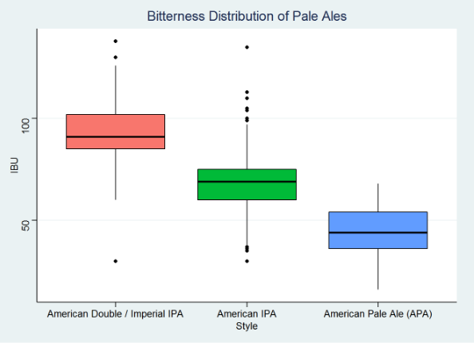
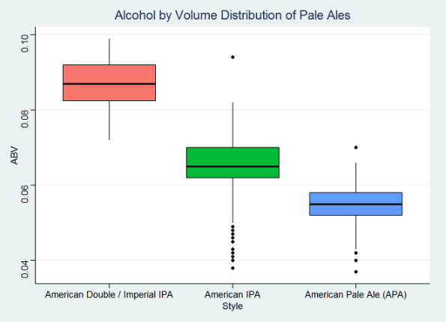
A New Beer Label
An ANOVA and Hypothesis tests for differences in IBU and ABV proved that there is overwhelming evidence that these three styles are distinctly different from each other (all p-values <.0001)
Brewers should aim for a bitterness of 50-60 and ABV of 6% to produce a beer that can still bear the “IPA” name
Notes:
We can also see in these bar plots that the core 75% of beers in each category do not overlap. But In order to test with full assurance that these are indeed still distinct styles, we ran an analysis of variance to provide statistical proof of any differences we could see visually, and those tests provided overwhelming evidence that all 3 of these styles are different.
We’ve concluded that our brewers should aim…
It’s a “stronger” beer than Bud is used to making, but it looks like the best course of action to start this new label off right.

